Slide 1

App Service Management Tools
[speaker]

Slide 2
Portal

Slide 3
Two Tips
Portal feature comparison
Internal portal

Slide 4
https://azure.microsoft.com/en-us/features/azure-portal/availability/

Slide 5
Internal portal
http://aka.ms/publicportal

Slide 6
CLI 2.0 (Preview)

Slide 8
Announcing Azure Command-Line Interface (CLI) 2.0 Preview
A new native Posix/BASH based Commandline experience
Available at GitHub in preview mode – looking for early feedback and engagement with adopters
Current xplat CLI will continue to be available and supported – will be needed for ASM services
Both CLIs work side-by-side in the same command shell window

Slide 9
Goals for the new release
Natural and easy to install
Native install scripts for every platform (Brew, apt-get, PIP, yum, MSI)
Consistent and works nicely with POSIX tools
Integrates well with GREP, AWK, JQ and all other common tools and commands
Productivity features for command completion, parameter values, help
Optimized for standalone commands, automation scripts
Part of Open Source ecosystem
Open sourced; Open to contributions (governance policy coming)
Ever-fresh with Azure
Consistent and complete coverage of all Azure services
Supports side-by-side install and usage with current xplat CLI (will continue to be available and supported)
Try it out – we want your feedback!

Slide 10
[optional]
ARM Template
Swagger
AutoRest
SDKs
CLI
"parameters": {
"size": {
"type": "string",
"defaultValue": "Standard_A2",
...
"VMParameters": {
"properties": {
"size": {
"type": "object",
"$ref": "#/definitions/DeploymentParameter_size",
"description": "The VM Size that should be created.",
"x-ms-client-flatten": true
VirtualMachine vm = subscription.virtualMachines().define("myVM")
.withRegion(Region.US_WEST)
.withNewResourceGroup("myresourcegroup")
.withNewNetwork("myVNnet", "10.0.0.0/28")
.withPrivateIpAddressDynamic()
.withNewPublicIpAddress()
.withLatestImage("MicrosoftWindowsServer", "WindowsServer", "2008-R2-SP1")
.withSize(Size.Type.Standard_A2)
.withNewStorageAccount()
.withNewDataDisk(100)
.provision();
$ az vm create
Usage az vm create <resource-group> <image> [size]
Options:
-h, --help Output usage and help information
--name <name> The virtual machine name
--size <instance-size> The VM Size that should be created.
--sshkey The SSH key
Full Swagger Spec
Example ARM Template
CLI Command Generator
Notes:
CLI 2.0 and the new Fluent SDK are actually built from the Swagger specs for the Azure service endpoints. It's a full end-to-end automated pipeline, so when a service is added or updated, everything's up to date and in-sync: CLI (both commands and help), SDK, docs.

Slide 11
Installation Walkthrough: Bash on Windows
https://aka.ms/getprojectaz
Native install scripts for every platform (Brew, apt-get, PIP, yum, MSI)
sudo apt-get update
sudo apt-get install -y libssl-dev libffi-dev
sudo apt-get install -y python-dev curl -L https://aka.ms/InstallAzureCli | sudo bash
exec -l $SHELL

Slide 12
Demo
Azure Command-Line Interface (CLI) 2.0 Preview

Slide 13
Notes:
This is a backup slide to quickly demo CLI 2.0 features

Slide 14
App Service Companion

Slide 15
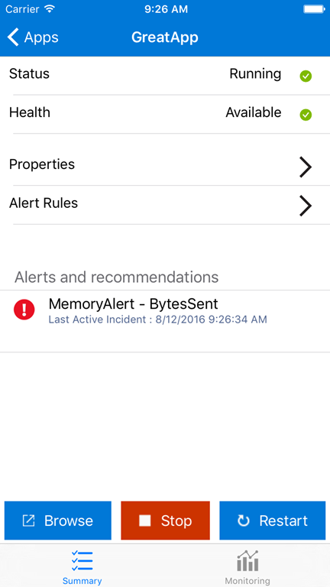
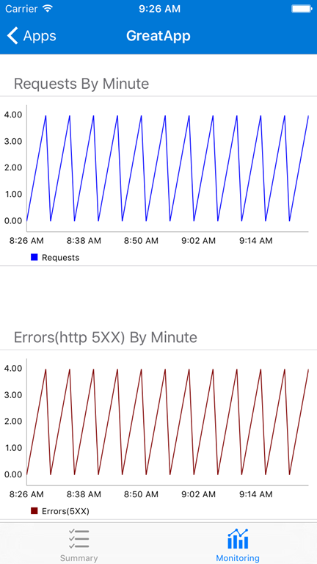
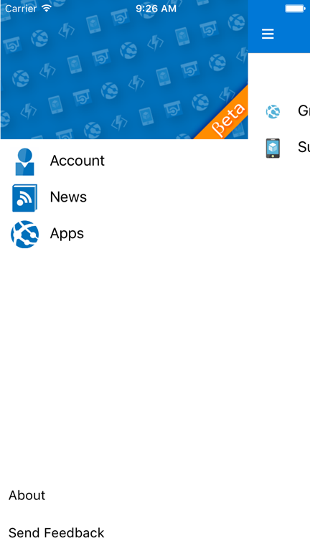
App Service Companion

Slide 16
App Service Companion
Android and iOS, US only currently
Xamarin app
Hockey app
Mobile app backend

Slide 17
Visual Studio

Slide 18
Introducing Linux on Azure App Service

Slide 19
Why Linux?

Slide 20
Be Where Your Customers Are
Its what customers want
One in every three VMs on Azure are Linux!
Its one of our top customer asks on UserVoice
This is a HUGE business opportunity for Microsoft in an as-of-yet untapped market for us
Supportability
Customer asks for application stacks like Ruby/Rails that work a lot better on Linux.
Customers bringing their PHP, Node.js and other workloads from Linux are running into issues
Many new up and coming frameworks are built for running on Linux first with Windows being an afterthought, like Meteor (which is our #1 ask on UserVoice)
Better tooling and support for frameworks like PHP, Node.js and Python

Slide 21
Embracing Change
Perception and options
Reinforce the “Microsoft <3 Linux” message
Azure is an open platform, we need to ‘manage’ Linux alternatives here.
Standing behind our platform offering: “We can do this great on Linux too!”
Riding the momentum for new development paradigms
Docker makes application portability very simple, and we would be remiss if we didn’t allow developers to deploy Docker containers.
Docker is also very popular for micro-service developers and we want to support development paradigm.
Serverless computation is gaining support and we want to bring Azure Functions on Linux as well. Combine this with micro-services architecture that is already quite popular, and we should be on the bleeding edge of managed offerings.

Slide 22
Demos
Basic create app and GitHub integration
Using Azure CLI to manage your web app
Using custom Docker images

Slide 23
Roadmap

Slide 24
Roadmap with Features
Connect() (Nov. 16th 2016) Public Preview Refresh
Devops
CI/CD with Local git and GitHub
Traffic routing
Site slots
Auto-detect app stack
Management
Ibiza portal
REST API (ARM) + NodeJS CLI
Scale out / up
Resource Health
Enterprise
Custom domains and SSL
Performance Test
RBAC
Runtime
PHP, NodeJs, .NET Core
Custom Docker Image
Diagnostics and Application Logs
Audit Logs
Ubuntu 16.04 LTS

Slide 25
Roadmap with Features
General Availability (Early CY 2017)
Devops
CI/CD with Local git and GitHub
Traffic routing, Site slots
Auto-detect app stack
Remote debugging
Docker: SSH, Custom image
Management
Ibiza portal
REST API (ARM) + NodeJS CLI
Scale out / up
Resource Health
Enterprise
Custom domains and SSL
Performance Test, RBAC
AD / OAuth integration
VNET integration
Security Hardening
Runtime
PHP, NodeJs, Ubuntu 16.04 LTS
.NET Core, Custom Docker images
Diagnostics and Application Logs
Java, Go, Rails, Python
Audit Logs
And other things depending on what YOU tell us

Slide 26
How do I engage
Forums
Search for “Azure App Service forums” to find our forums
Use stackoverflow, tag it with azure-web-sites
Documentation comments
Put a comment below any of our docs / blogs and we will get back to you.
Twitter
You can always tweet to me @nazimlala

